Slide 1
Problem Solving

Slide 2
Problem Characteristics in Artificial Intelligence
Since artificial intelligence (AI) is mainly related to the search process, it is important to have some methodology to choose the best possible solution.
To choose an appropriate method for a particular problem first we need to categorize the problem based on the following characteristics.
Is the problem decomposable into small sub-problems which are easy to solve?
Can solution steps be ignored or undone?
Is the universe of the problem is predictable?
Is a good solution to the problem is absolute or relative?
Is the solution to the problem a state or a path?
What is the role of knowledge in solving a problem using artificial intelligence?
Does the task of solving a problem require human interaction?

Slide 3
State space search
Before an agent can start searching for solutions, a goal must be identified and a well defined problem must be formulated.
A problem can be defined formally by these components:
The initial state that the agent starts in.
A description of the possible actions available to the agent.
A description of what each action does; the formal name for this is the transition model.
Together, the initial state, actions, and transition model implicitly define the state space of the problem—the set of all states reachable from the initial state by any sequence of actions.

Slide 4
Simple algorithm for any search problem:
Do until a solution is found or the state space is exhausted.
1. Check the current state
2. Execute allowable actions to find the successor states.
3. Pick one of the new states.
4. Check if the new state is a solution state
If it is not, the new state becomes the current state and the process is repeated.

Slide 5
Real world search problems
Route-finding problems
• GPS-based navigation systems, Google maps
Touring problems
• TSP problem
• VLSI layout problems
• Robot navigation problems
• Internet searching
• Searching paths in metabolic networks in bioinformatics

Slide 6
Search Algorithm Terminologies
Search: Searching is a step by step procedure to solve a search-problem in a given search space. A search problem can have three main factors:
Search Space: Search space represents a set of possible solutions, which a system may have.
Start State: It is a state from where agent begins the search.
Goal test: It is a function which observe the current state and returns whether the goal state is achieved or not.
Search tree: A tree representation of search problem is called Search tree. The root of the search tree is the root node which is corresponding to the initial state.
Actions: It gives the description of all the available actions to the agent.
Transition model: A description of what each action do, can be represented as a transition model.
Path Cost: It is a function which assigns a numeric cost to each path.
Solution: It is an action sequence which leads from the start node to the goal node.
Optimal Solution: If a solution has the lowest cost among all solutions.

Slide 7
Properties of Search Algorithms
Completeness: A search algorithm is said to be complete if it guarantees to return a solution if at least any solution exists for any random input.
Optimality: If a solution found for an algorithm is guaranteed to be the best solution (lowest path cost) among all other solutions, then such a solution for is said to be an optimal solution.
Time Complexity: Time complexity is a measure of time for an algorithm to complete its task.
Space Complexity: It is the maximum storage space required at any point during the search, as the complexity of the problem

Slide 8
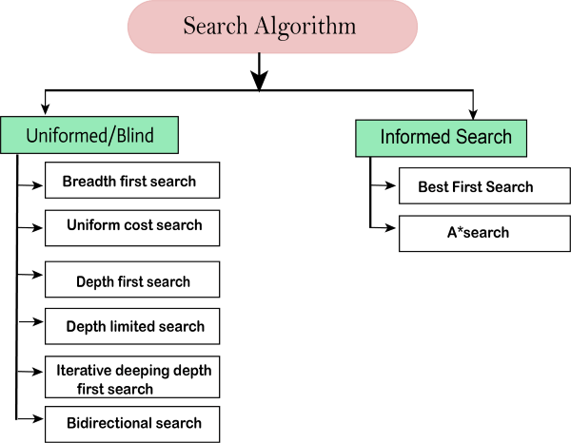
Types of search algorithms

Slide 9
Uninformed search
Uninformed search applies a way in which search tree is searched without any information about the search space like initial state operators and test for the goal, so it is also called blind search.
It can be divided into these main types:
Breadth-first Search
Depth-first Search
Depth-limited Search
Iterative deepening depth-first search
Uniform cost search
Bidirectional Search

Slide 10
Informed search or Heuristic search
1. Simple heuristic search
Greedy best-first search
A* search algorithm
2. Memory bounded heuristic
a. Iterative deepening A*(IDA*)
b. Recursive best-first search
c. Simplified memory bounded A*
3. Local search algorithms & optimization problems
a. Hill climbing search
b. simulated annealing search
c. local beam search
d. genetic algorithms
4. Constraint satisfaction search
5. Adversary search

Slide 11
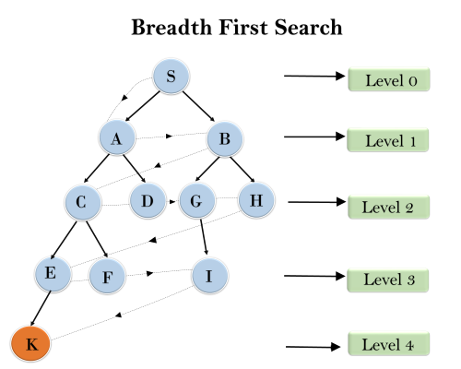
1. Breadth-first Search:
Breadth-first search is the most common search strategy for traversing a tree or graph. This algorithm searches breadth wise in a tree or graph, so it is called breadth-first search.
BFS algorithm starts searching from the root node of the tree and expands all successor node at the current level before moving to nodes of next level.
S---> A--->B---->C--->D---->G--->H--->E---->F---->I---->K

Slide 12
S---> A--->B---->C--->D---->G--->H--->E---->F---->I---->K

Slide 13
2. Depth-first Search
Depth-first search is a recursive algorithm for traversing a tree or graph data structure.
It is called the depth-first search because it starts from the root node and follows each path to its greatest depth node before moving to the next path.

Slide 14
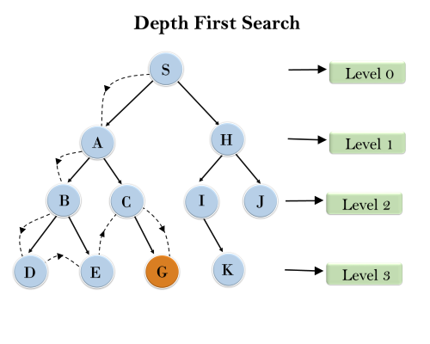
It will start searching from root node S, and traverse A, then B, then D and E, after traversing E, it will backtrack the tree as E has no other successor and still goal node is not found. After backtracking it will traverse node C and then G, and here it will terminate as it found goal node.

Slide 15
3. Depth-Limited Search Algorithm
A depth-limited search algorithm is similar to depth-first search with a predetermined limit. Depth-limited search can solve the drawback of the infinite path in the Depth-first search. In this algorithm, the node at the depth limit will treat as it has no successor nodes further.
Depth-limited search can be terminated with two Conditions of failure:
Standard failure value: It indicates that problem does not have any solution.
Cutoff failure value: It defines no solution for the problem within a given depth limit.

Slide 16
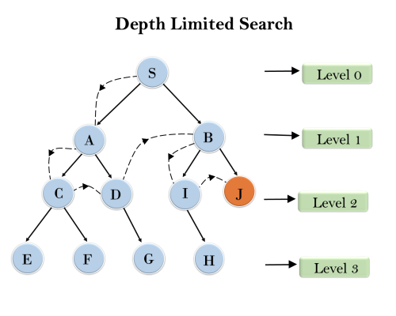

Slide 17
Advantages:
Depth-limited search is Memory efficient.
Disadvantages:
Depth-limited search also has a disadvantage of incompleteness.
It may not be optimal if the problem has more than one solution.

Slide 18
4. Iterative deepening depth-first Search
This algorithm performs depth-first search up to a certain "depth limit", and it keeps increasing the depth limit after each iteration until the goal node is found.
This Search algorithm combines the benefits of Breadth-first search's fast search and depth-first search's memory efficiency.
The iterative search algorithm is useful uninformed search when search space is large, and depth of goal node is unknown.

Slide 19
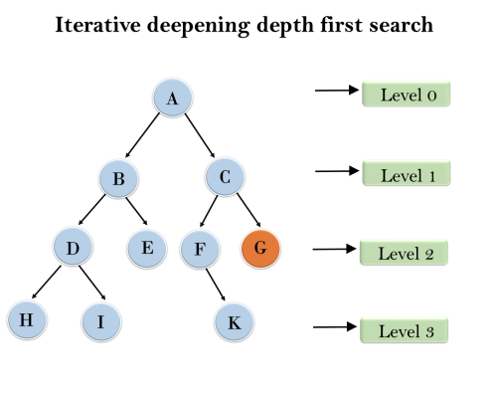
1'st Iteration-----> A 2'nd Iteration----> A, B, C 3'rd Iteration------>A, B, D, E, C, F, G 4'th Iteration------>A, B, D, H, I, E, C, F, K, G In the fourth iteration, the algorithm will find the goal node.

Slide 20
Advantages
IDDFS gives us the hope to find the solution if it exists in the tree.
IDS is memory-efficient. IDS minimizes the algorithm's memory footprint by only storing the nodes up to the current depth limit.
IDS's ability to be utilized for both tree and graph search is its third benefit. This is due to the fact that IDS is a generic search algorithm that works on any search space, including a tree or a graph.
The time taken is exponential to reach the goal node.
The main problem with IDDFS is the time and wasted calculations that take place at each depth.
Disadvantages

Slide 21
5. Uniform-cost Search Algorithm:
Uniform-cost search is a searching algorithm used for traversing a weighted tree or graph
The primary goal of the uniform-cost search is to find a path to the goal node which has the lowest cumulative cost.
It can be used to solve any graph/tree where the optimal cost is in demand.
A uniform-cost search algorithm is implemented by the priority queue.
It gives maximum priority to the lowest cumulative cost.

Slide 22
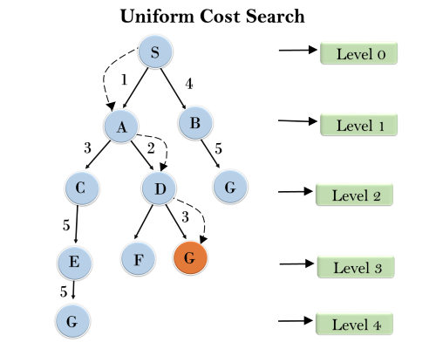

Slide 23
Advantages:
Uniform cost search is optimal because at every state the path with the least cost is chosen.
Disadvantages:
It does not care about the number of steps involve in searching and only concerned about path cost. Due to which this algorithm may be stuck in an infinite loop.

Slide 24
6. Bidirectional Search Algorithm:
Bidirectional search algorithm runs two simultaneous searches, one form initial state called as forward-search and other from goal node called as backward-search, to find the goal node. Bidirectional search replaces one single search graph with two small sub-graphs in which one starts the search from an initial vertex and other starts from goal vertex. The search stops when these two graphs intersect each other.
Bidirectional search can use search techniques such as BFS, DFS, DLS, etc.
In bidirectional search, one should know the goal state in advance.

Slide 25
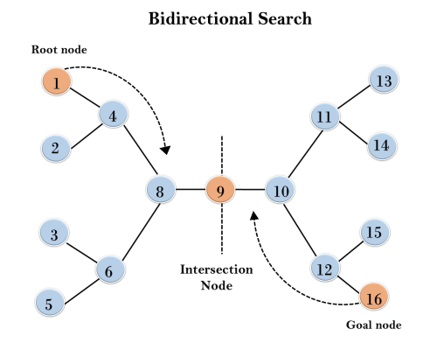
In the below search tree, bidirectional search algorithm is applied. This algorithm divides one graph/tree into two sub-graphs. It starts traversing from node 1 in the forward direction and starts from goal node 16 in the backward direction.
The algorithm terminates at node 9 where two searches meet.

Slide 26
Informed Search Algorithms
Heuristics function:
Heuristic is a function which is used in Informed Search, and it finds the most promising path.
It might not always give the best solution, but it guaranteed to find a good solution in reasonable time.
Admissibility of the heuristic function is given as:
h(n) <= h*(n)
Here h(n) is heuristic cost, and h*(n) is the estimated cost. Hence heuristic cost should be less than or equal to the estimated cost.

Slide 27
Pure Heuristic Search:
Pure heuristic search is the simplest form of heuristic search algorithms. It expands nodes based on their heuristic value h(n).
In the informed search we will discuss two main algorithms which are given below:
Best First Search Algorithm(Greedy search)
A* Search Algorithm

Slide 28
1.Best-first Search Algorithm (Greedy Search)
Greedy best-first search algorithm always selects the path which appears best at that moment. With the help of best-first search, at each step, we can choose the most promising node.
Best first search algorithm:
Step 1: Place the starting node into the OPEN list.
Step 2: If the OPEN list is empty, Stop and return failure.
Step 3: Remove the node n, from the OPEN list which has the lowest value of h(n), and places it in the CLOSED list.
Step 4: Expand the node n, and generate the successors of node n.
Step 5: Check each successor of node n, and find whether any node is a goal node or not. If any successor node is goal node, then return success and terminate the search, else proceed to Step 6.
Step 6: For each successor node, algorithm checks for evaluation function f(n), and then check if the node has been in either OPEN or CLOSED list. If the node has not been in both list, then add it to the OPEN list.
Step 7: Return to Step 2.

Slide 29
Advantages:
Best first search can switch between BFS and DFS by gaining the advantages of both the algorithms.
This algorithm is more efficient than BFS and DFS algorithms.
Disadvantages:
It can behave as an unguided depth-first search in the worst case scenario.
It can get stuck in a loop as DFS.
This algorithm is not optimal.

Slide 30
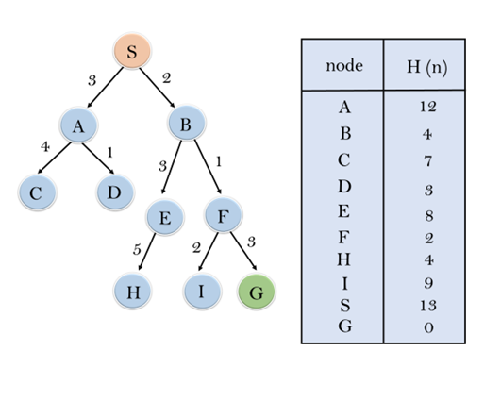

Slide 31
In this search example, we are using two lists which are OPEN and CLOSED Lists. Following are the iteration for traversing the above example.
Expand the nodes of S and put in the CLOSED list
Initialization: Open [A, B], Closed [S]
Iteration 1: Open [A], Closed [S, B]
Iteration 2: Open [E, F, A], Closed [S, B] : Open [E, A], Closed [S, B, F]
Iteration 3: Open [I, G, E, A], Closed [S, B, F] : Open [I, E, A], Closed [S, B, F, G]
Hence the final solution path will be: S----> B----->F----> G
Time Complexity: The worst case time complexity of Greedy best first search is O(b^{m}).
Space Complexity: The worst case space complexity of Greedy best first search is O(b^{m}). Where, m is the maximum depth of the search space.
Complete: Greedy best-first search is also incomplete, even if the given state space is finite.
Optimal: Greedy best first search algorithm is not optimal.

Slide 32
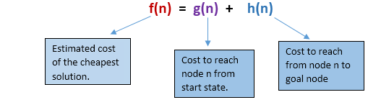
2. A* Search Algorithm:
It uses heuristic function h(n), and cost to reach the node n from the start state g(n).
A* search algorithm finds the shortest path through the search space using the heuristic function.
This search algorithm expands less search tree and provides optimal result faster
In A* search algorithm, we use search heuristic as well as the cost to reach the node. Hence we can combine both costs as following, and this sum is called as a fitness number.
At each point in the search space, only those node is expanded which have the lowest value of f(n)

Slide 33
Algorithm of A* search:
Step1: Place the starting node in the OPEN list.
Step 2: Check if the OPEN list is empty or not, if the list is empty then return failure and stops.
Step 3: Select the node from the OPEN list which has the smallest value of evaluation function (g+h), if node n is goal node then return success and stop, otherwise
Step 4: Expand node n and generate all of its successors, and put n into the closed list. For each successor n', check whether n' is already in the OPEN or CLOSED list, if not then compute evaluation function for n' and place into Open list.
Step 5: Else if node n' is already in OPEN and CLOSED, then it should be attached to the back pointer which reflects the lowest g(n') value.
Step 6: Return to Step 2.

Slide 34
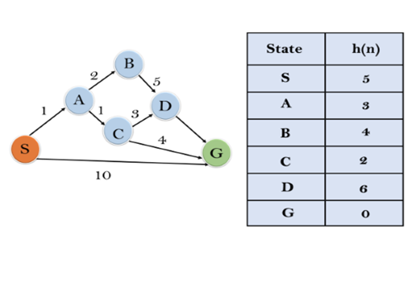
Example:
In this example, we will traverse the given graph using the A* algorithm. The heuristic value of all states is given in the below table so we will calculate the f(n) of each state using the formula f(n)= g(n) + h(n), where g(n) is the cost to reach any node from start state.
Here we will use OPEN and CLOSED list.

Slide 35
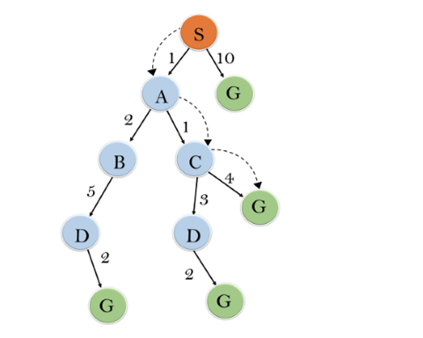
Initialization: {(S, 5)}
Iteration1: {(S--> A, 4), (S-->G, 10)}
Iteration2: {(S--> A-->C, 4), (S--> A-->B, 7), (S-->G, 10)}
Iteration3: {(S--> A-->C--->G, 6), (S--> A-->C--->D, 11), (S--> A-->B, 7), (S-->G, 10)}
Iteration 4 will give the final result, as S--->A--->C--->G it provides the optimal path with cost 6.

Slide 36
Initialization: {(S, 5)}
Iteration1: {(S--> A, 4), (S-->G, 10)}
Iteration2: {(S--> A-->C, 4), (S--> A-->B, 7), (S-->G, 10)}
Iteration3: {(S--> A-->C--->G, 6), (S--> A-->C--->D, 11), (S--> A-->B, 7), (S-->G, 10)}
Iteration 4 will give the final result, as S--->A--->C--->G it provides the optimal path with cost 6.

Slide 37
Advantages:
A* search algorithm is the best algorithm than other search algorithms.
A* search algorithm is optimal and complete.
This algorithm can solve very complex problems.
Disadvantages:
It does not always produce the shortest path as it mostly based on heuristics and approximation.
A* search algorithm has some complexity issues.
The main drawback of A* is memory requirement as it keeps all generated nodes in the memory, so it is not practical for various large-scale problems.

Slide 38
Optimal: A* search algorithm is optimal if it follows below two conditions:
Admissible: the first condition requires for optimality is that h(n) should be an admissible heuristic for A* tree search. An admissible heuristic is optimistic in nature.
Consistency: Second required condition is consistency for only A* graph-search.

Slide 39
Hill Climbing Algorithm
One of the widely discussed examples of Hill climbing algorithm is Traveling-salesman Problem in which we need to minimize the distance traveled by the salesman.
It is also called greedy local search as it only looks to its good immediate neighbor state and not beyond that.
Features of Hill Climbing:
Following are some main features of Hill Climbing Algorithm:
Generate and Test variant: Hill Climbing is the variant of Generate and Test method. The Generate and Test method produce feedback which helps to decide which direction to move in the search space.
Greedy approach: Hill-climbing algorithm search moves in the direction which optimizes the cost.
No backtracking: It does not backtrack the search space, as it does not remember the previous states.

Slide 40
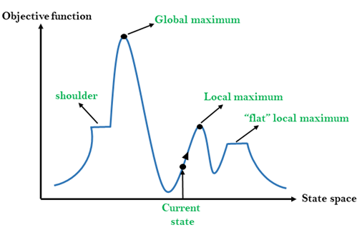
Different regions in the state space landscape:
Local Maximum: Local maximum is a state which is better than its neighbor states, but there is also another state which is higher than it.
Global Maximum: Global maximum is the best possible state of state space landscape. It has the highest value of objective function.
Current state: It is a state in a landscape diagram where an agent is currently present.
Flat local maximum: It is a flat space in the landscape where all the neighbor states of current states have the same value.
Shoulder: It is a plateau region which has an uphill edge.

Slide 41
Simple Hill Climbing:
Simple hill climbing is the simplest way to implement a hill climbing algorithm. It only evaluates the neighbor node state at a time and selects the first one which optimizes current cost and set it as a current state. It only checks it's one successor state, and if it finds better than the current state, then move else be in the same state. This algorithm has the following features:
Less time consuming
Less optimal solution and the solution is not guaranteed
Algorithm for Simple Hill Climbing:
Step 1: Evaluate the initial state, if it is goal state then return success and Stop.
Step 2: Loop Until a solution is found or there is no new operator left to apply.
Step 3: Select and apply an operator to the current state.
Step 4: Check new state:
If it is goal state, then return success and quit.
Else if it is better than the current state then assign new state as a current state.
Else if not better than the current state, then return to step2.
Step 5: Exit.

Slide 42
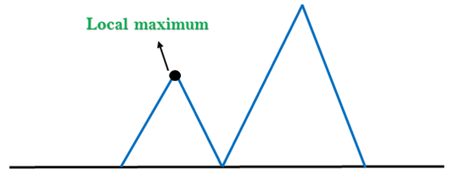
Problems in Hill Climbing Algorithm:
1. Local Maximum: A local maximum is a peak state in the landscape which is better than each of its neighboring states, but there is another state also present which is higher than the local maximum.
Solution: Backtracking technique can be a solution of the local maximum in state space landscape. Create a list of the promising path so that the algorithm can backtrack the search space and explore other paths as well.

Slide 43
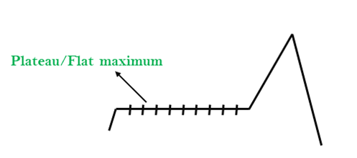
2. Plateau: A plateau is the flat area of the search space in which all the neighbor states of the current state contains the same value, because of this algorithm does not find any best direction to move. A hill-climbing search might be lost in the plateau area.
Solution: The solution for the plateau is to take big steps or very little steps while searching, to solve the problem. Randomly select a state which is far away from the current state so it is possible that the algorithm could find non-plateau region.

Slide 44
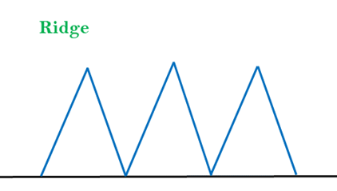
3. Ridges: A ridge is a special form of the local maximum. It has an area which is higher than its surrounding areas, but itself has a slope, and cannot be reached in a single move.
Solution: With the use of bidirectional search, or by moving in different directions, we can improve this problem.

